Slide 1
Advanced Out-Of-Distribution (OOD) Detection for Multi-Class Classification
Author: Janne David Rotter

Slide 2
Outline
Introduction
Related Work
Proposed Methods
Datasets and Metrics
Implementation details
Experimental results
Conclusion and future work
References

Slide 3
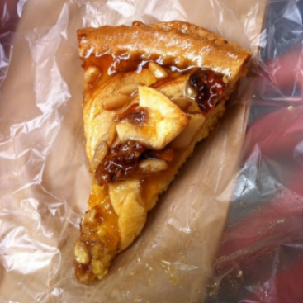
Introduction
Assume we have a deep multi-class classification model F
Bruschetta | 0.01
Applepie | 0.85
Pizza | 0.02
… | …
ID-Data
Model F
Fig. 1: Purpose of OOD Detection

Slide 4
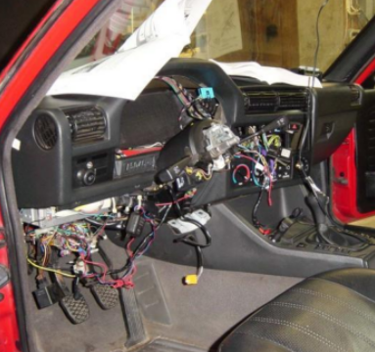
Introduction
Assume we have a deep multi-class classification model F
Bruschetta | 0.23
Applepie | 0.14
Pizza | 0.11
… | …
ID-Data
Model F
Based on context overconfident predictions on OOD data can pose significant challenges e.g. safety concerns^{[1]}
OOD-Data
Fig. 1: Purpose of OOD Detection

Slide 5
Related Work
Two approaches to OOD-Detection:
Exposure to auxiliary data: Train the model on ID and OOD data^{[2,3]}
Post-hoc methods: Train the model only on ID data and then use model characteristics in response to input sample as score^{[1,4,5,6,7]}
While the first method usually leads to better OOD detection it tends to lead to increased training cost and potentially comprises model performance^{[8]}

Slide 6
Proposed Methods
Leverage transfer learning for model training
Finetune Efficientnet-B0^{[10]} on Food-101 dataset according to best approach found by Phillip et al.^{[9]}
We save precious training time when not having to tune hyperparameters
Use standard transformation for all samples and augmentation on train split

Slide 7
Proposed Methods
Implement multiple post-hoc OOD detection solutions and compare:
Maximum Softmax Probability (MSP)^{[5]}
Out-Of-Distribution Detector (ODIN)^{[4]}
Energy score^{[1]}
Gradient Norm (GradNorm)^{[7]}
Feature Norm (FeatureNorm)^{[6]}
Ensemble Method
Additionally evaluate how well these metrics work on different model accuracies

Slide 8
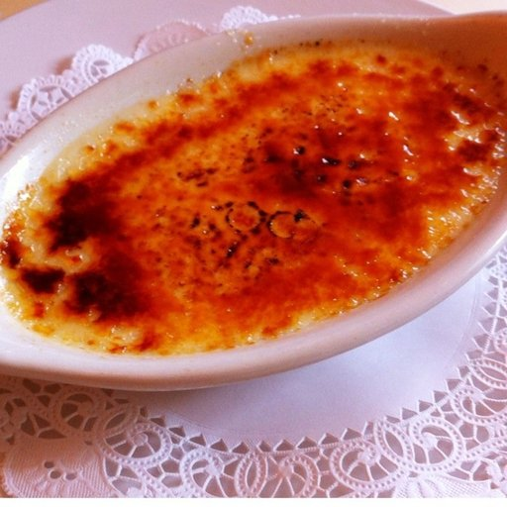
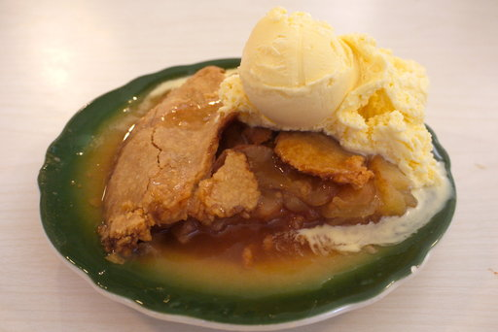


Datasets and Metrics
ID-Dataset: Food-101^{[11]}
Real-world food images
101 classes with 1000 images each
OOD-Dataset: Street View House Numbers (SVHN)^{[12]}
Real-world house number images
~600,000 cropped images

Slide 9

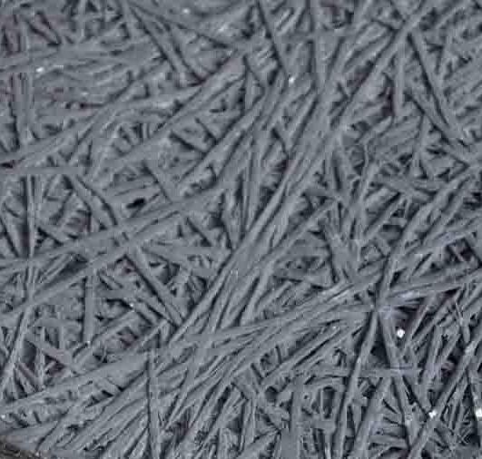
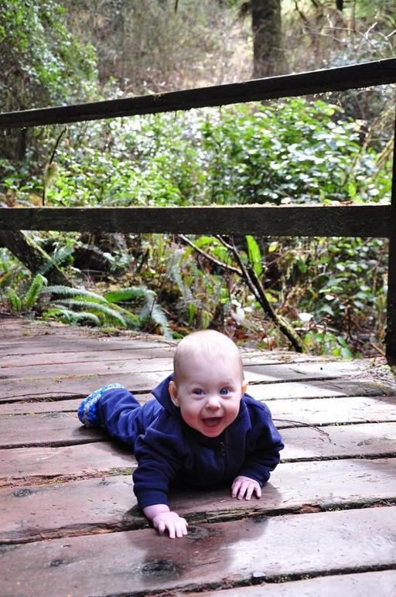
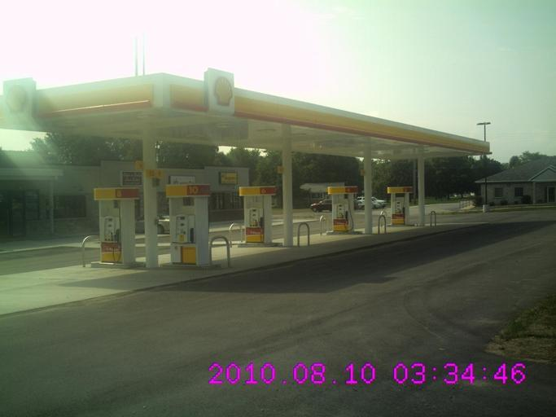
Datasets and Metrics
OOD-Dataset: Textures DTD^{[13]}
Images of textures
5640 images
OOD-Dataset: Places-365 small^{[14]}
Real-world images of scenes
1.8 million images in 365 categories
All of the OOD-Datasets were chosen because their semantic dissimilarity to the Food-101 dataset and their research adaptation^{[1,7]}

Slide 10
Datasets and Metrics
To evaluate the OOD methods I used two metrics with wide research adaptation^{[1,4,7,8,15]}:
Area Under the Receiver Operator Curve (AUROC)
False Positive Rate at 95% True Positive Rate (FPR95)

Slide 11
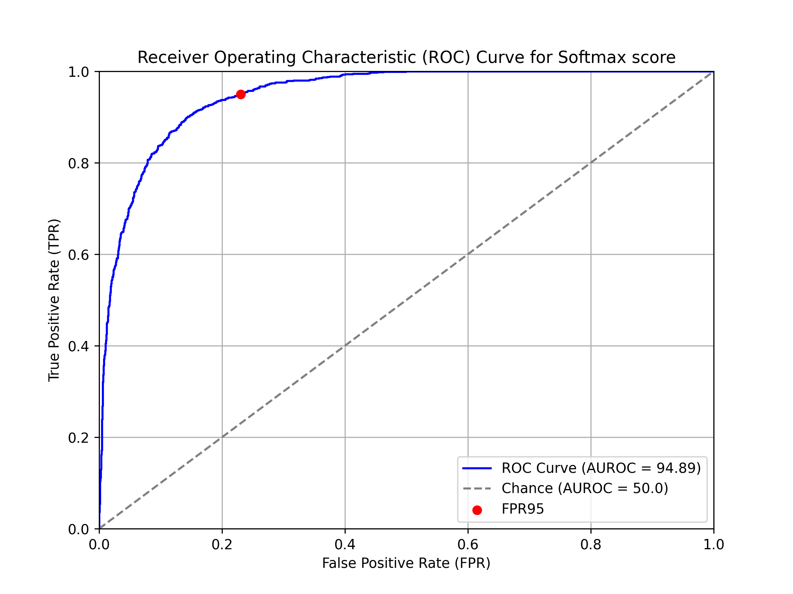
Datasets and Metrics
Fig. 2: Example ROC curve

Slide 12
Implementation Detail
Python3 running in Google Colab using PyTorch framework
Bottleneck: Limited GPU usage (T4 GPU)
The model achieves up to 77.20% Top-1 accuracy on ID-test split
We keep intermediate model parameters during training for later evaluation

Slide 13
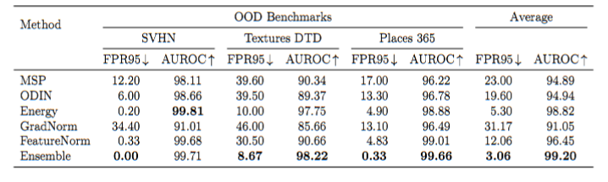
Experimental results
Table 1: OOD-Detection Performance

Slide 14
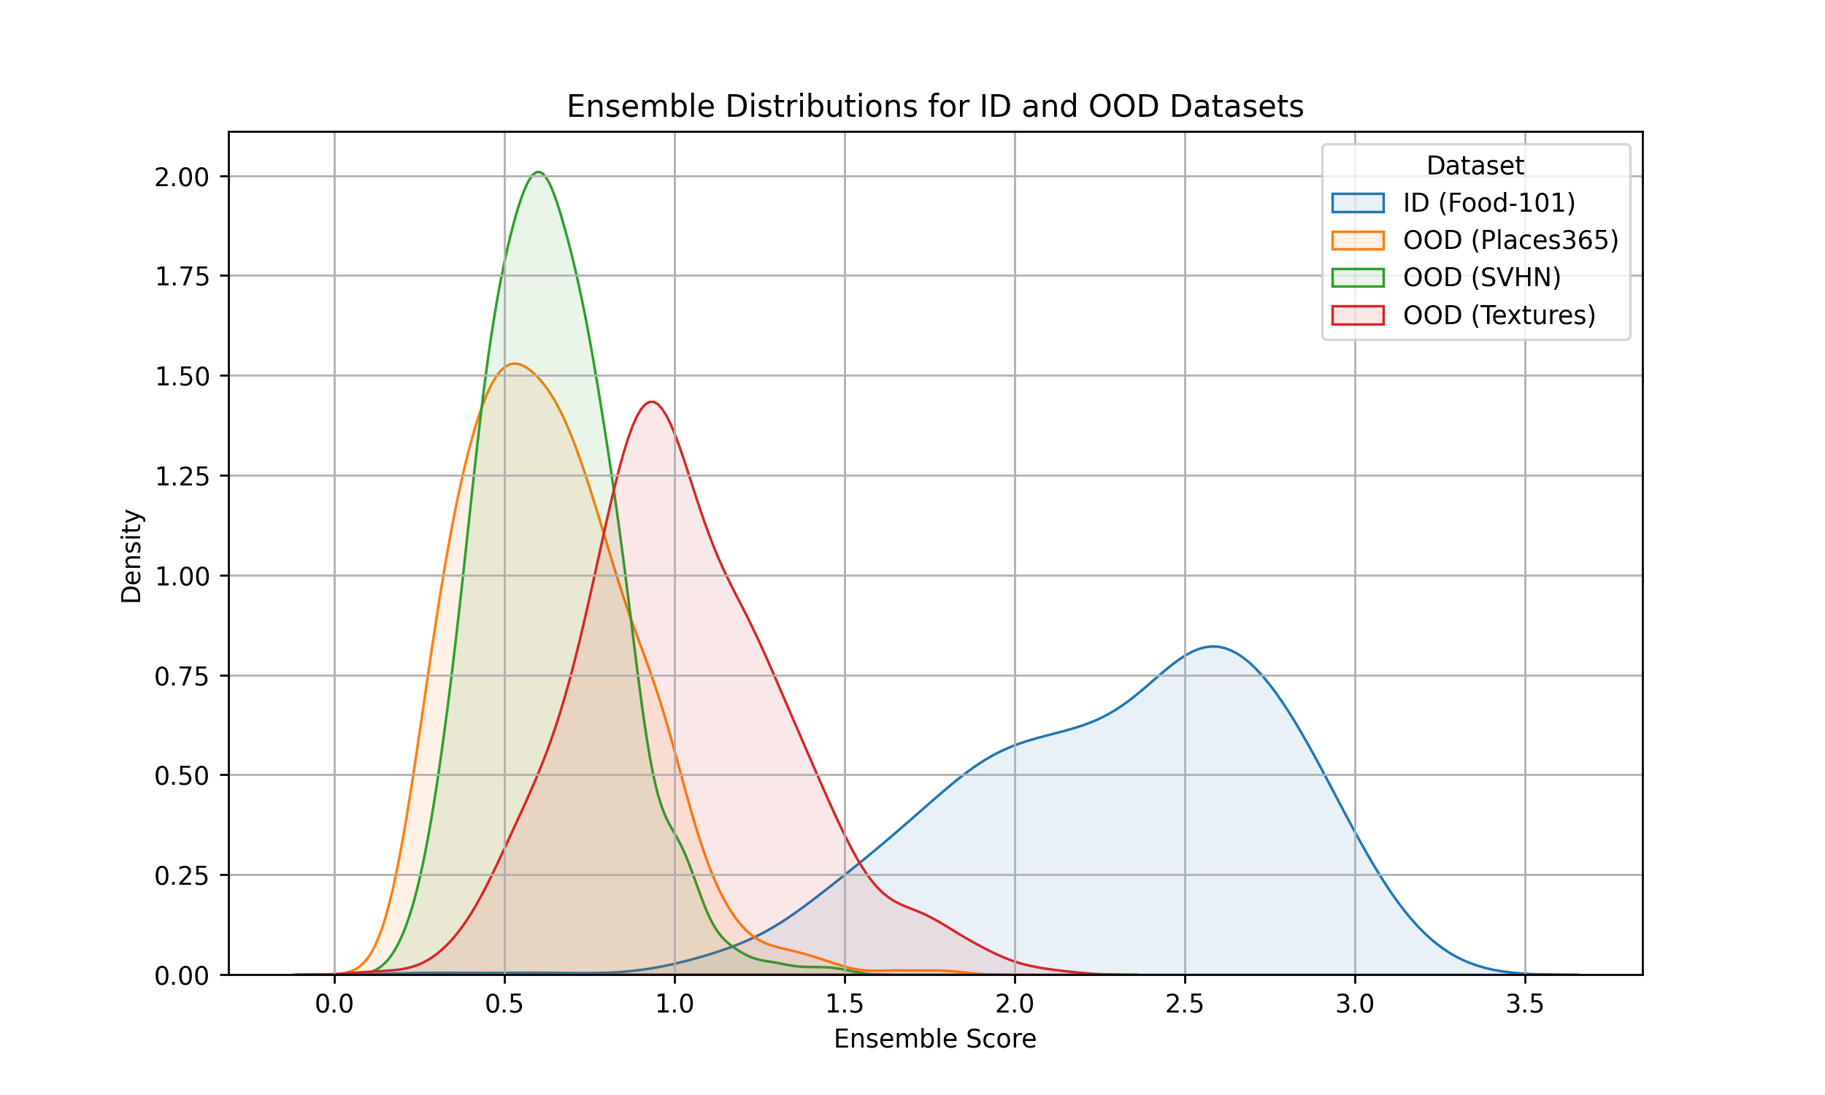
Experimental results
Example visualization of the Ensemble score results
Fig 3: Ensemble Score Distribution

Slide 15
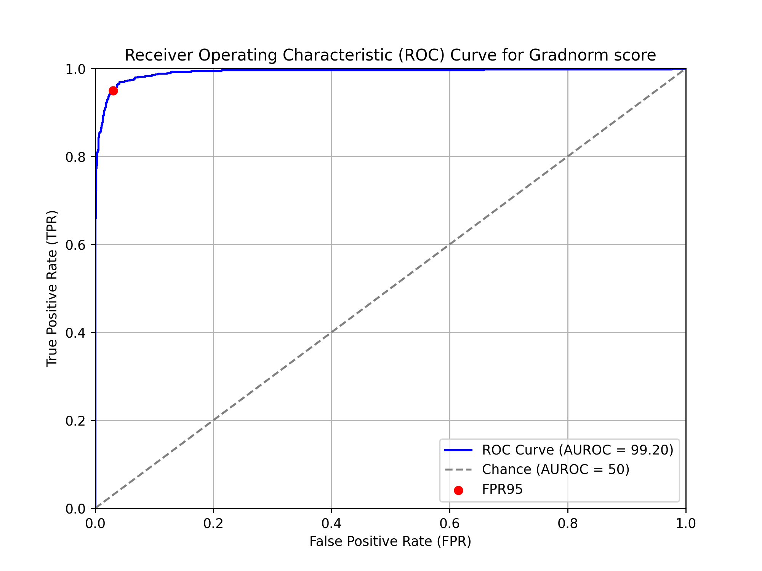
Experimental results
Example visualization of the Ensemble score results
Fig 3: Ensemble Score ROC curve

Slide 16
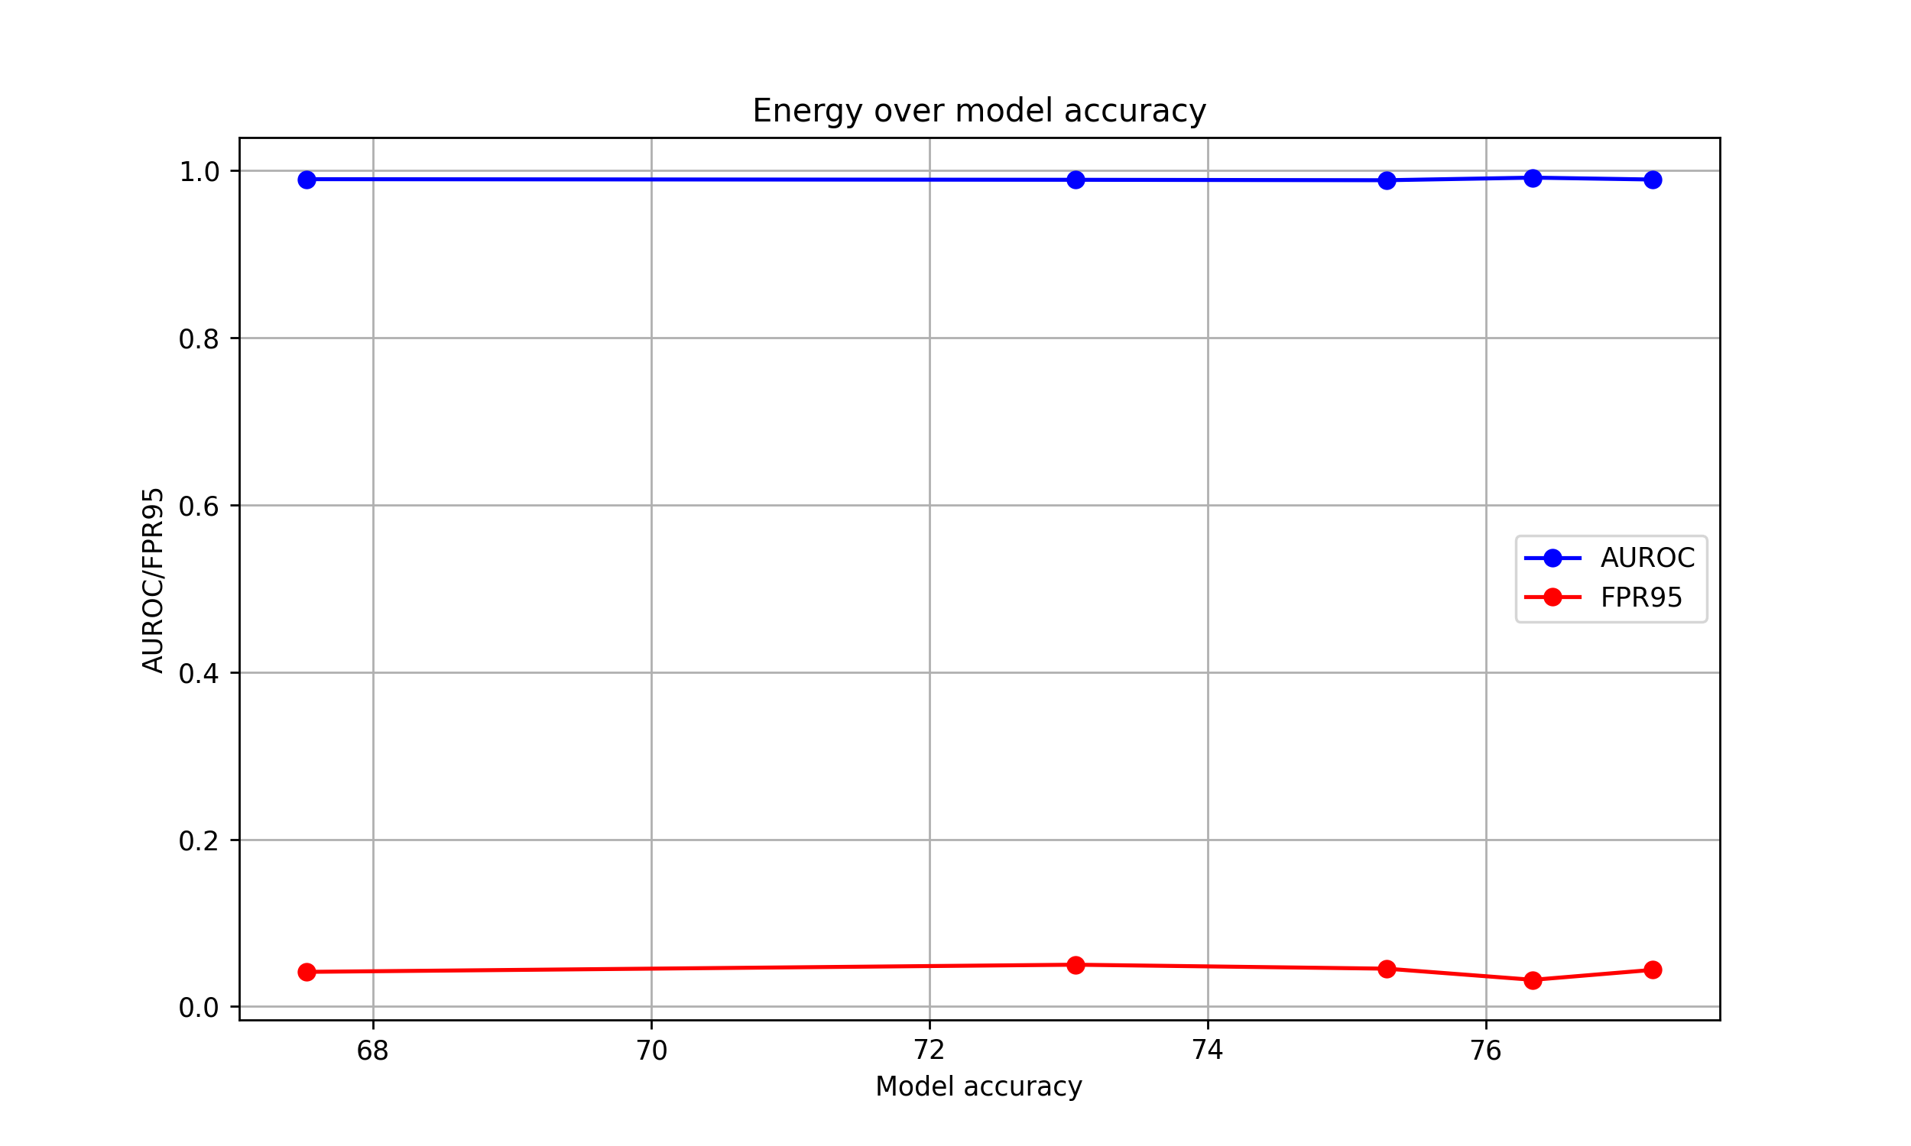
Experimental results
Visualization of energy score depending on model accuracy
Note that this was only evaluated on 700 images per model per dataset (high noise expected)
Fig 4: Energy Score over model accuracy
Notes:
This form is characteristic and more or less the same for each score

Slide 17
Conclusion and future work
In the given setting the ensemble method seems to perform best
This was to be expected^{[17]}
Different methods perform differently depending on the OOD-Dataset
This is also supported by contemporary research^{[1,8]}

Slide 18
Conclusion and future work
Limitations and future works:
Computational resources bottleneck
Experimentations on larger junks of dataset
Better model training
Usage of more diverse datasets
Evaluate ensemble method on different benchmarks

Slide 19
References
[1] Liu, W., Wang, X., Owens, J., & Li, Y. (2020). Energy-based out-of-distribution detection. Advances in neural information processing systems, 33, 21464-21475.
[2] Hendrycks, D., Mazeika, M., & Dietterich, T. (2018). Deep anomaly detection with outlier exposure. arXiv preprint arXiv:1812.04606.
[3] Lee, K., Lee, H., Lee, K., & Shin, J. (2017). Training confidence-calibrated classifiers for detecting out-of-distribution samples. arXiv preprint arXiv:1711.09325.
[4] Liang, S., Li, Y., & Srikant, R. (2017). Enhancing the reliability of out-of-distribution image detection in neural networks. arXiv preprint arXiv:1706.02690.

Slide 20
References
[5] Hendrycks, D., & Gimpel, K. (2016). A baseline for detecting misclassified and out-of-distribution examples in neural networks. arXiv preprint arXiv:1610.02136.
[6] Dhamija, A. R., Günther, M., & Boult, T. (2018). Reducing network agnostophobia. Advances in Neural Information Processing Systems, 31.
[7] Huang, R., Geng, A., & Li, Y. (2021). On the importance of gradients for detecting distributional shifts in the wild. Advances in Neural Information Processing Systems, 34, 677-689.
[8] Tang, K., Hou, C., Peng, W., Chen, R., Zhu, P., Wang, W., & Tian, Z. (2024). CORES: Convolutional response-based score for out-of-distribution detection. In Proceedings of the IEEE/CVF Conference on Computer Vision and Pattern Recognition (pp. 10916-10925).

Slide 21
References
[9] Philip, A. R. (2024). Optimizing Food101 Classification with Transfer Learning: A Fine-Tuning Approach Using EfficientNetB0. International Journal of Intelligent Information Systems, 13(4), 59-77.
[10] Tan, M., & Le, Q. (2019, May). Efficientnet: Rethinking model scaling for convolutional neural networks. In International conference on machine learning (pp. 6105-6114). PMLR.
[11] TensorFlow Datasets. (n.d.). Food-101 [Data set]. TensorFlow. https://www.tensorflow.org/datasets/catalog/food101
[12] Netzer, Y., Wang, T., Coates, A., Bissacco, A., Wu, B., & Ng, A. Y. (2011). Street View House Numbers (SVHN) [Data set]. Stanford University. http://ufldl.stanford.edu/housenumbers/

Slide 22
References
[13] TensorFlow Datasets. (n.d.). Textures DTD [Data set]. TensorFlow. https://www.tensorflow.org/datasets/catalog/dtd
[14] TensorFlow Datasets. (n.d.). Places 365 Small [Data set]. TensorFlow. https://www.tensorflow.org/datasets/catalog/places365_small
[15] Sharifi, S., Entesari, T., Safaei, B., Patel, V. M., & Fazlyab, M. (2024, September). Gradient-regularized out-of-distribution detection. In European Conference on Computer Vision (pp. 459-478). Cham: Springer Nature Switzerland.
[16] Ahmed, T. (2020). Architecture of EfficientNet-B0 with MBConv as basic building blocks [Figure]. In Understanding EfficientNet: A Modern CNN Architecture. ResearchGate. https://www.researchgate.net/figure/Architecture-of-EfficientNet-B0-with-MBConv-as-Basic-building-blocks_fig4_344410350

Slide 23
References
[17] Yang, D., Mai Ngoc, K., Shin, I., Lee, K. H., & Hwang, M. (2021). Ensemble-based out-of-distribution detection. Electronics, 10(5), 567.

Slide 24
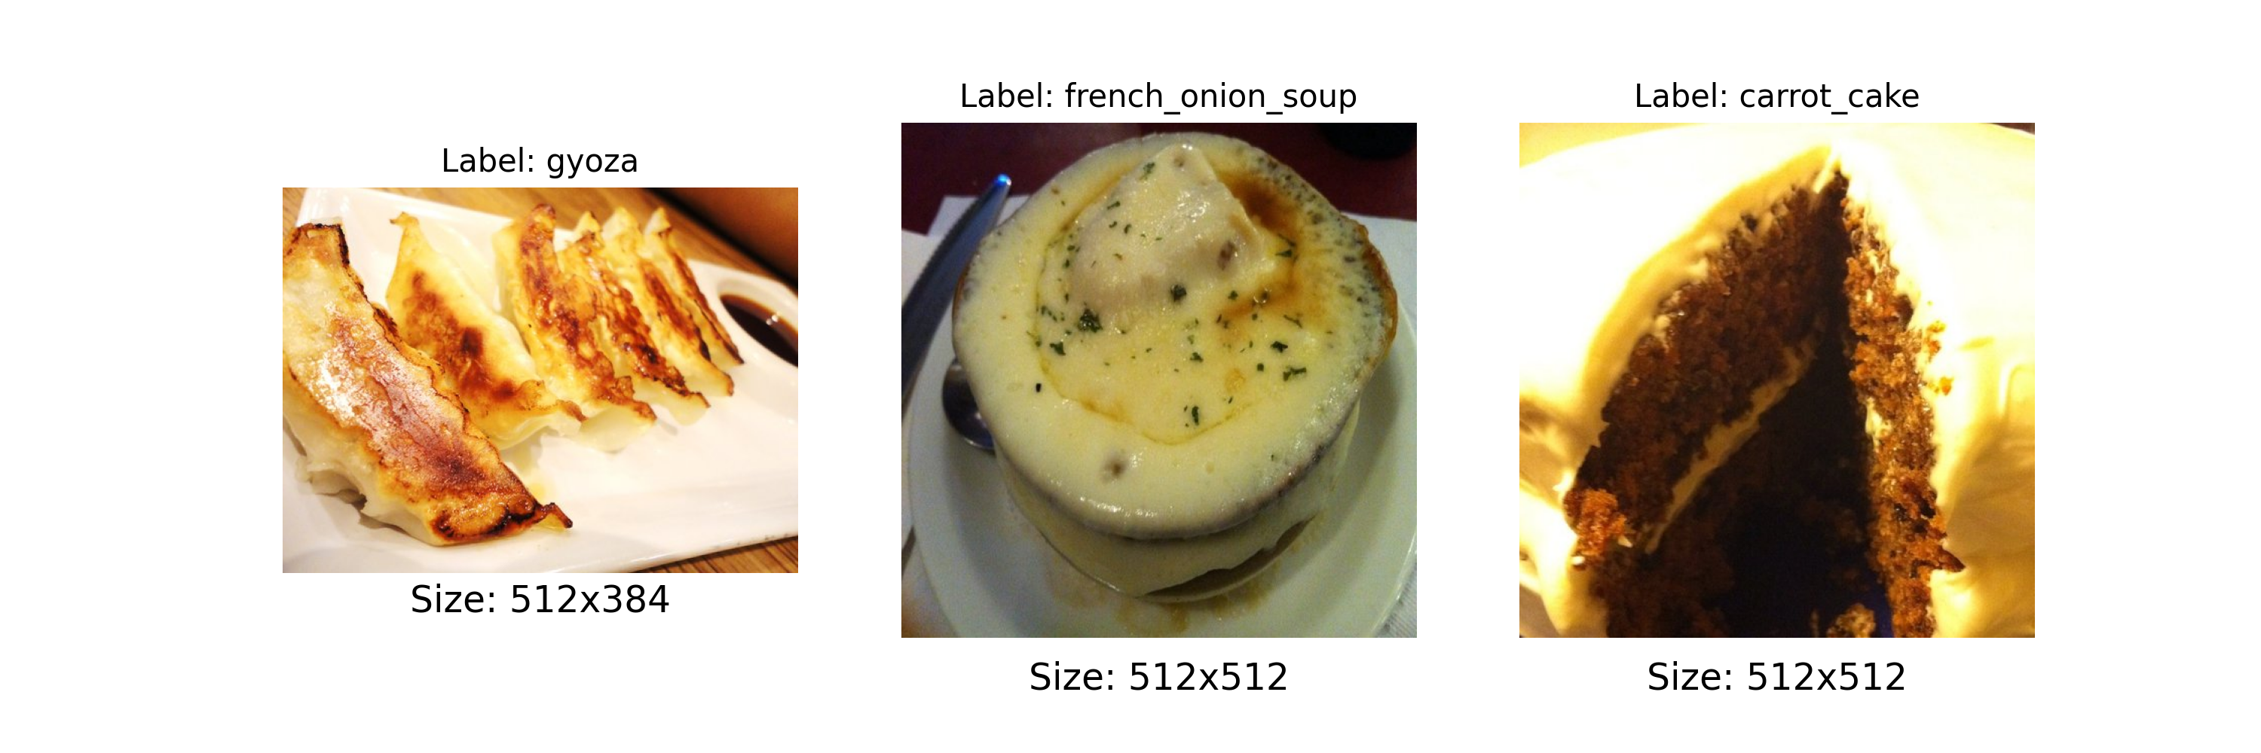
ID-Data samples

Slide 25
Augmentation Pipeline
Augmentation includes:
Random horizontal flip
Random crop
Random rotation (small angles)
Random color jitter
Random Gaussian noise
Augmentation is applied with 50% probability

Slide 26
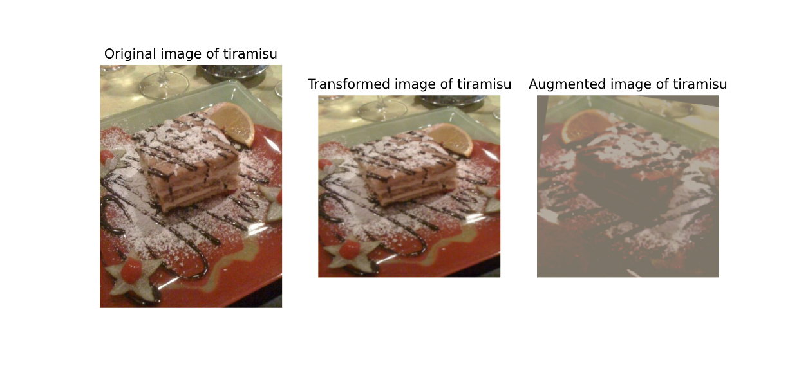
Augmentation Pipeline

Slide 27
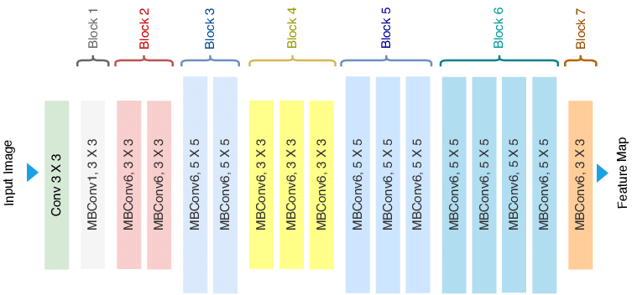
The Efficient-Net B0
EfficientNets are mainly chosen for their compound scaling method, which systematically adjusts the network’s width, depth, and input resolution together using predefined scaling coefficients.
B0 is the most lightweight version of the Efficient-Net family
Fig. 4: Efficintnet B0 architecture^{[16]}

Slide 28
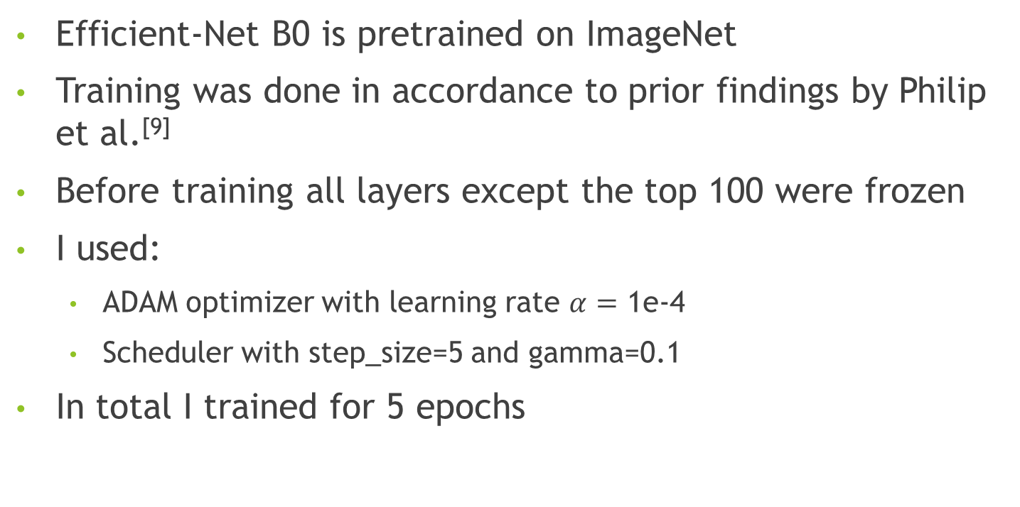
Training Process and hyperparameters
Efficient-Net B0 is pretrained on ImageNet
Training was done in accordance to prior findings by Philip et al.^{[9]}
Before training all layers except the top 100 were frozen
I used:
ADAM optimizer with learning rate $α=$ 1e-4
Scheduler with step_size=5 and gamma=0.1
In total I trained for 5 epochs

Slide 29
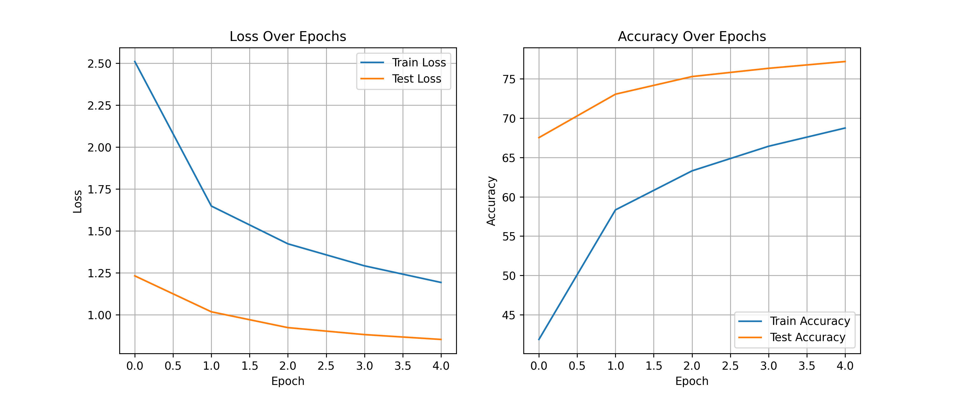
Training Process and hyperparameters

Slide 30
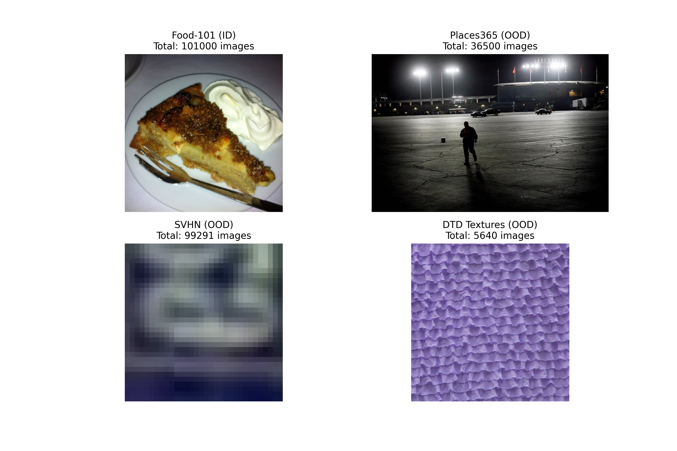
Direct Dataset Comparison

Slide 31
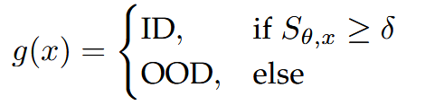

How does Score-based OOD detection work?
Given our model weights $θ$ and input sample $x$ compute a score $S_{θ,x}$
Classify sample based on function g and threshold $δ$

Slide 32
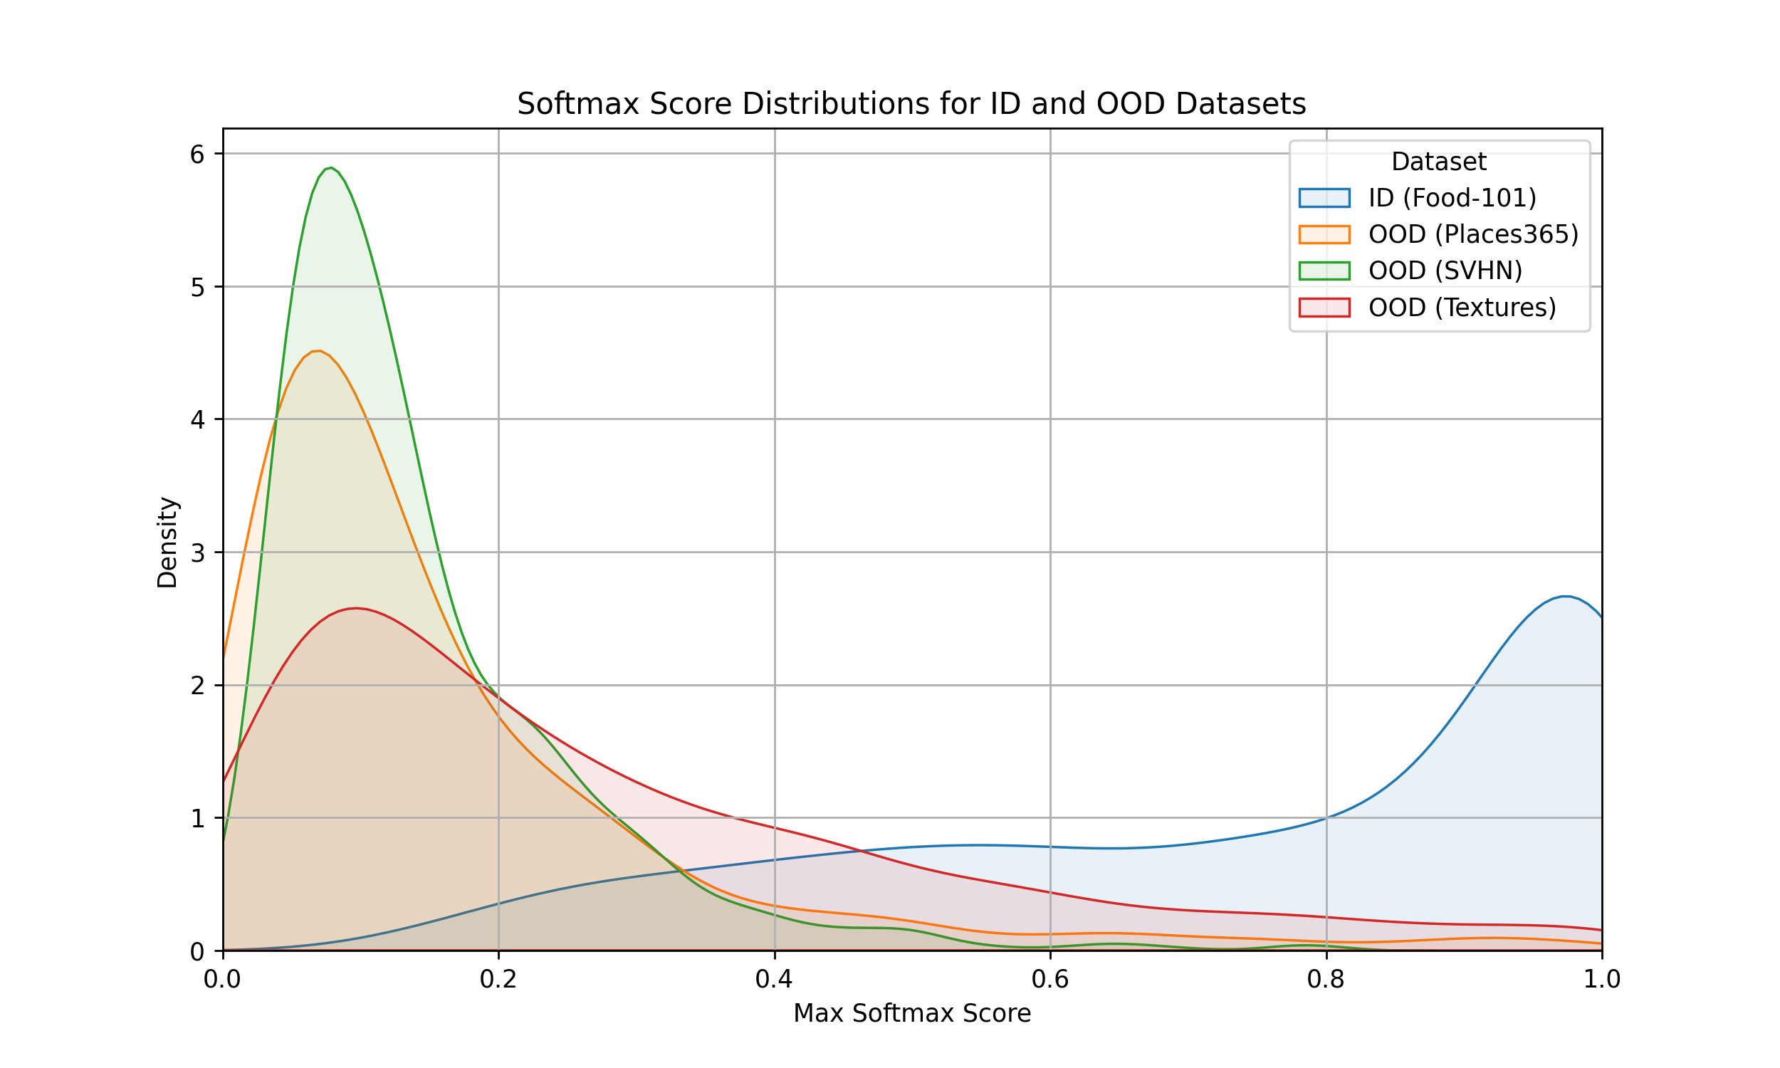
MSP
MSP works by taking the maximum SoftMax probability of a sample as a score^{[5]}

Slide 33
MSP

Slide 34
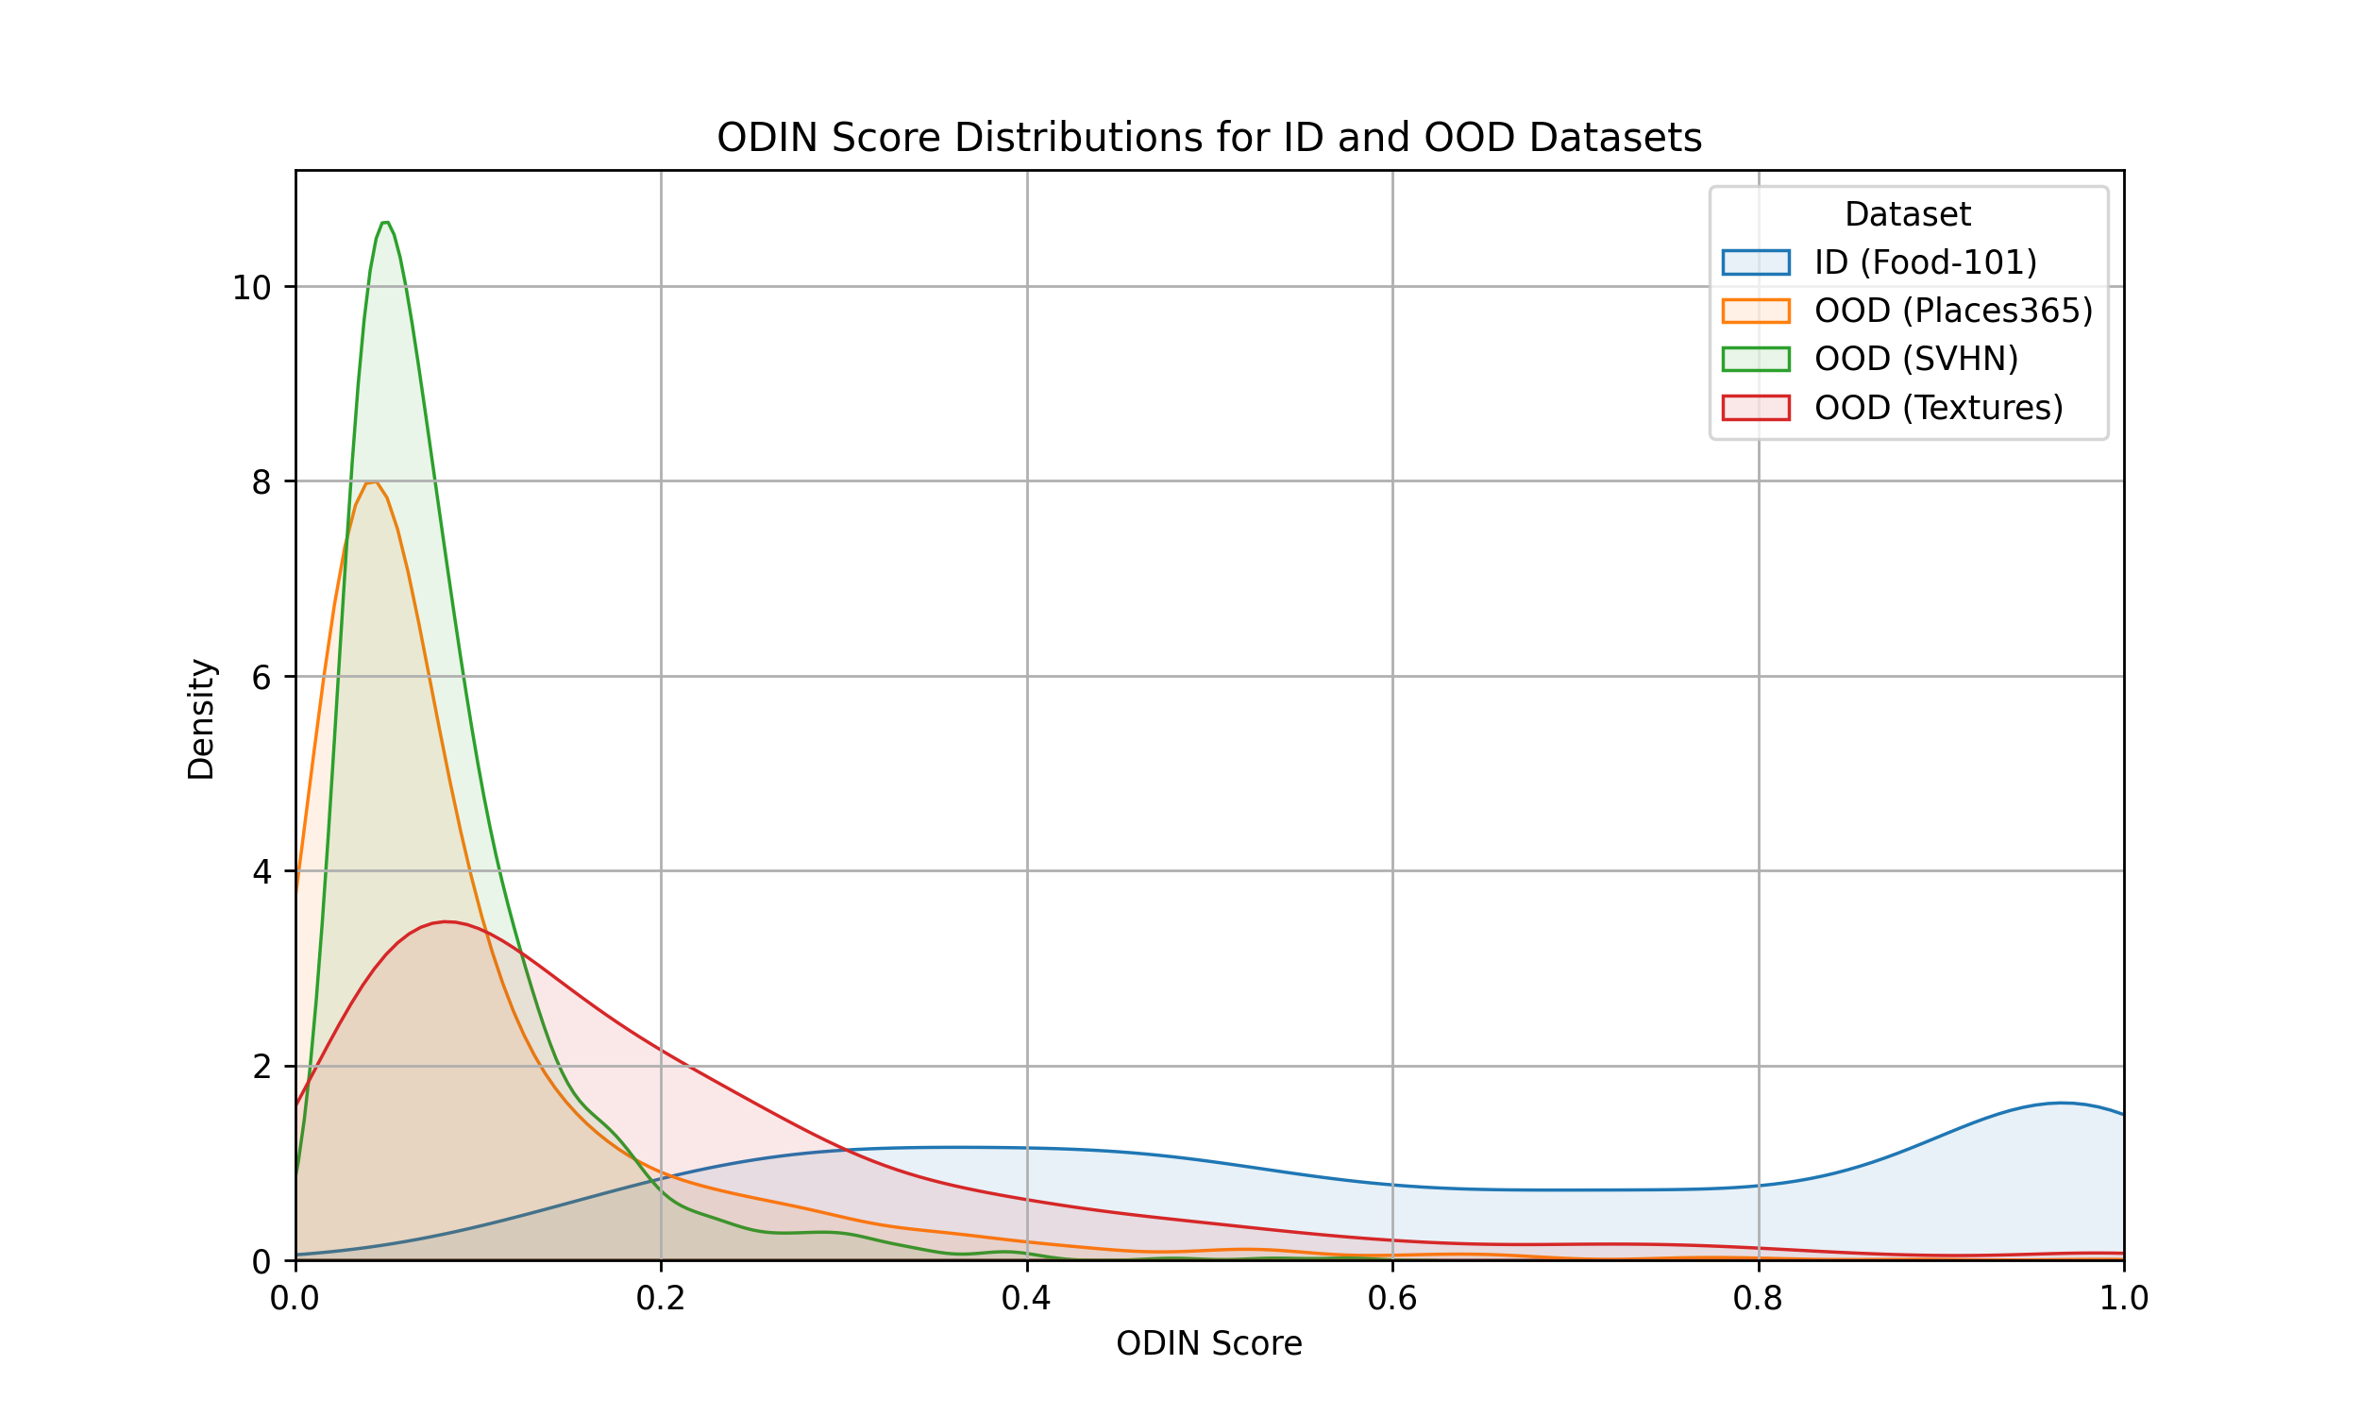
ODIN
Improves on the simple MSP approach by adding temperature scaling and input preprocessing in which the softmax score of any given input is increased, without the need for a class label at all^{[4]}

Slide 35
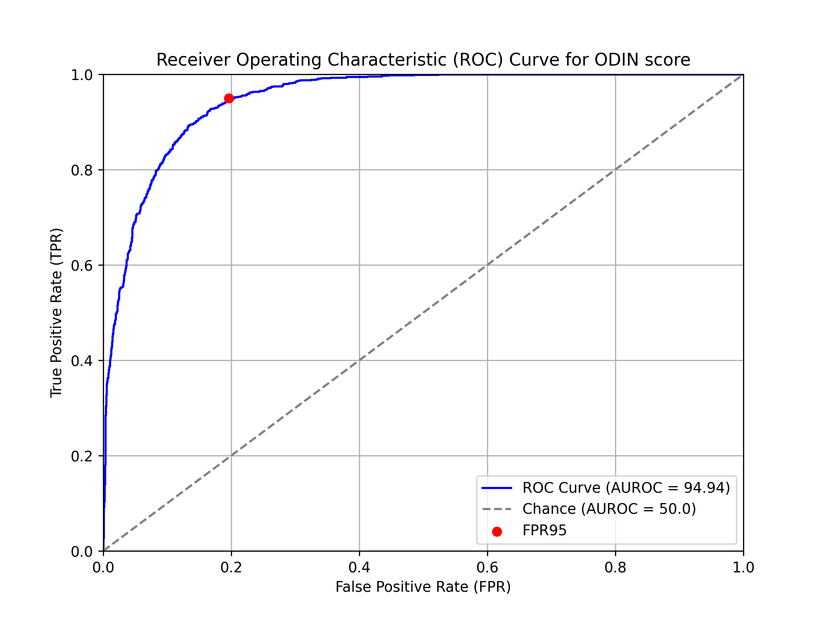
ODIN

Slide 36

Energy score
Instead of taking the MSP we calculate an energy score from the raw logits:^{[1]}

Slide 37
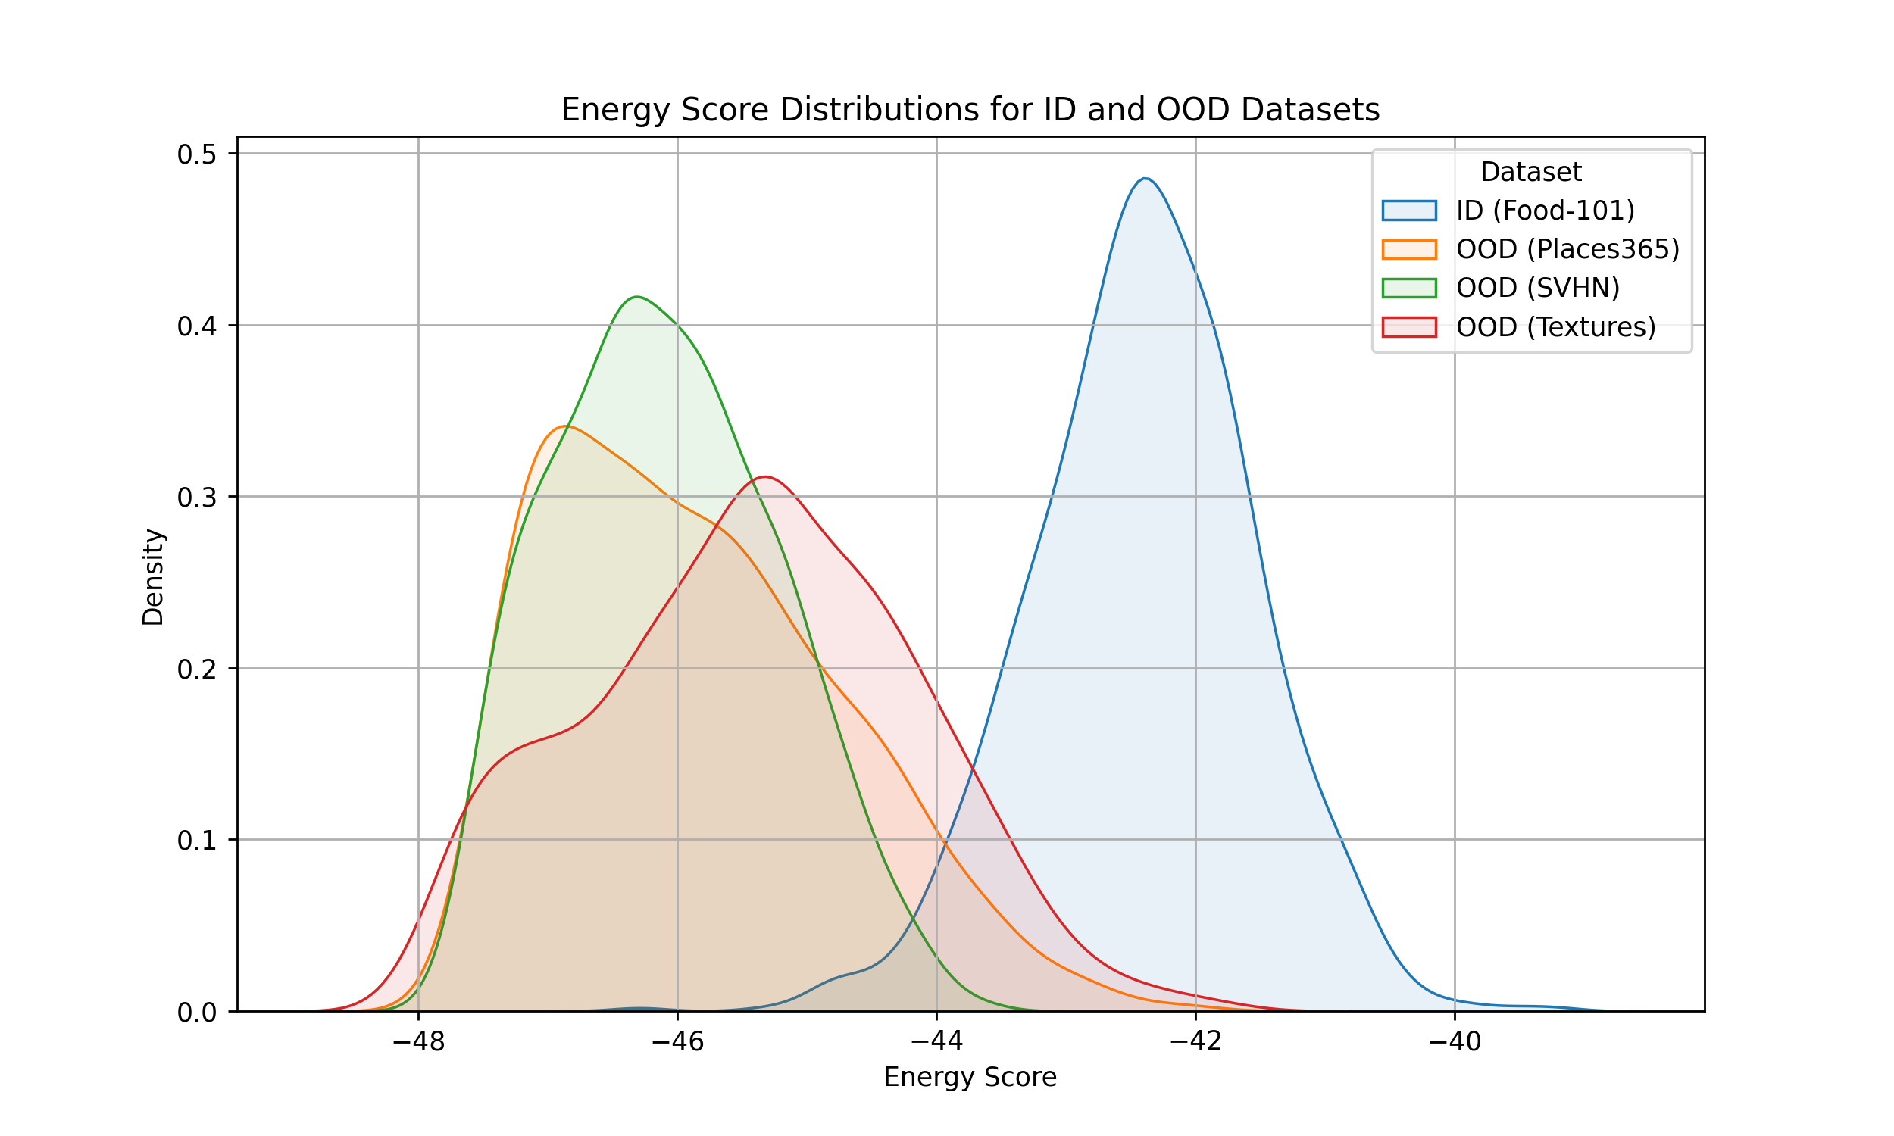
Energy score

Slide 38
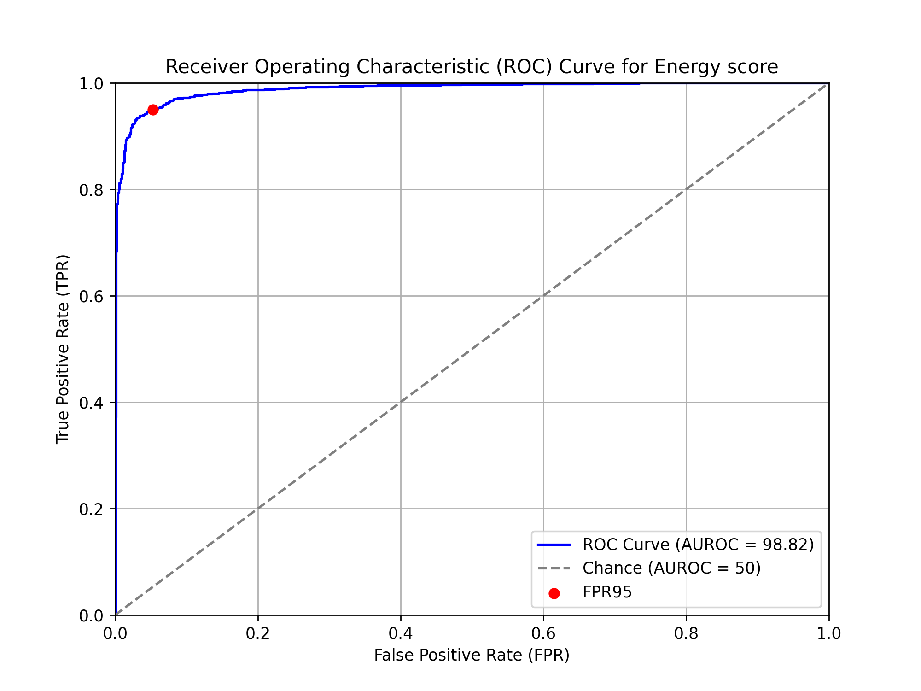
Energy Score

Slide 39
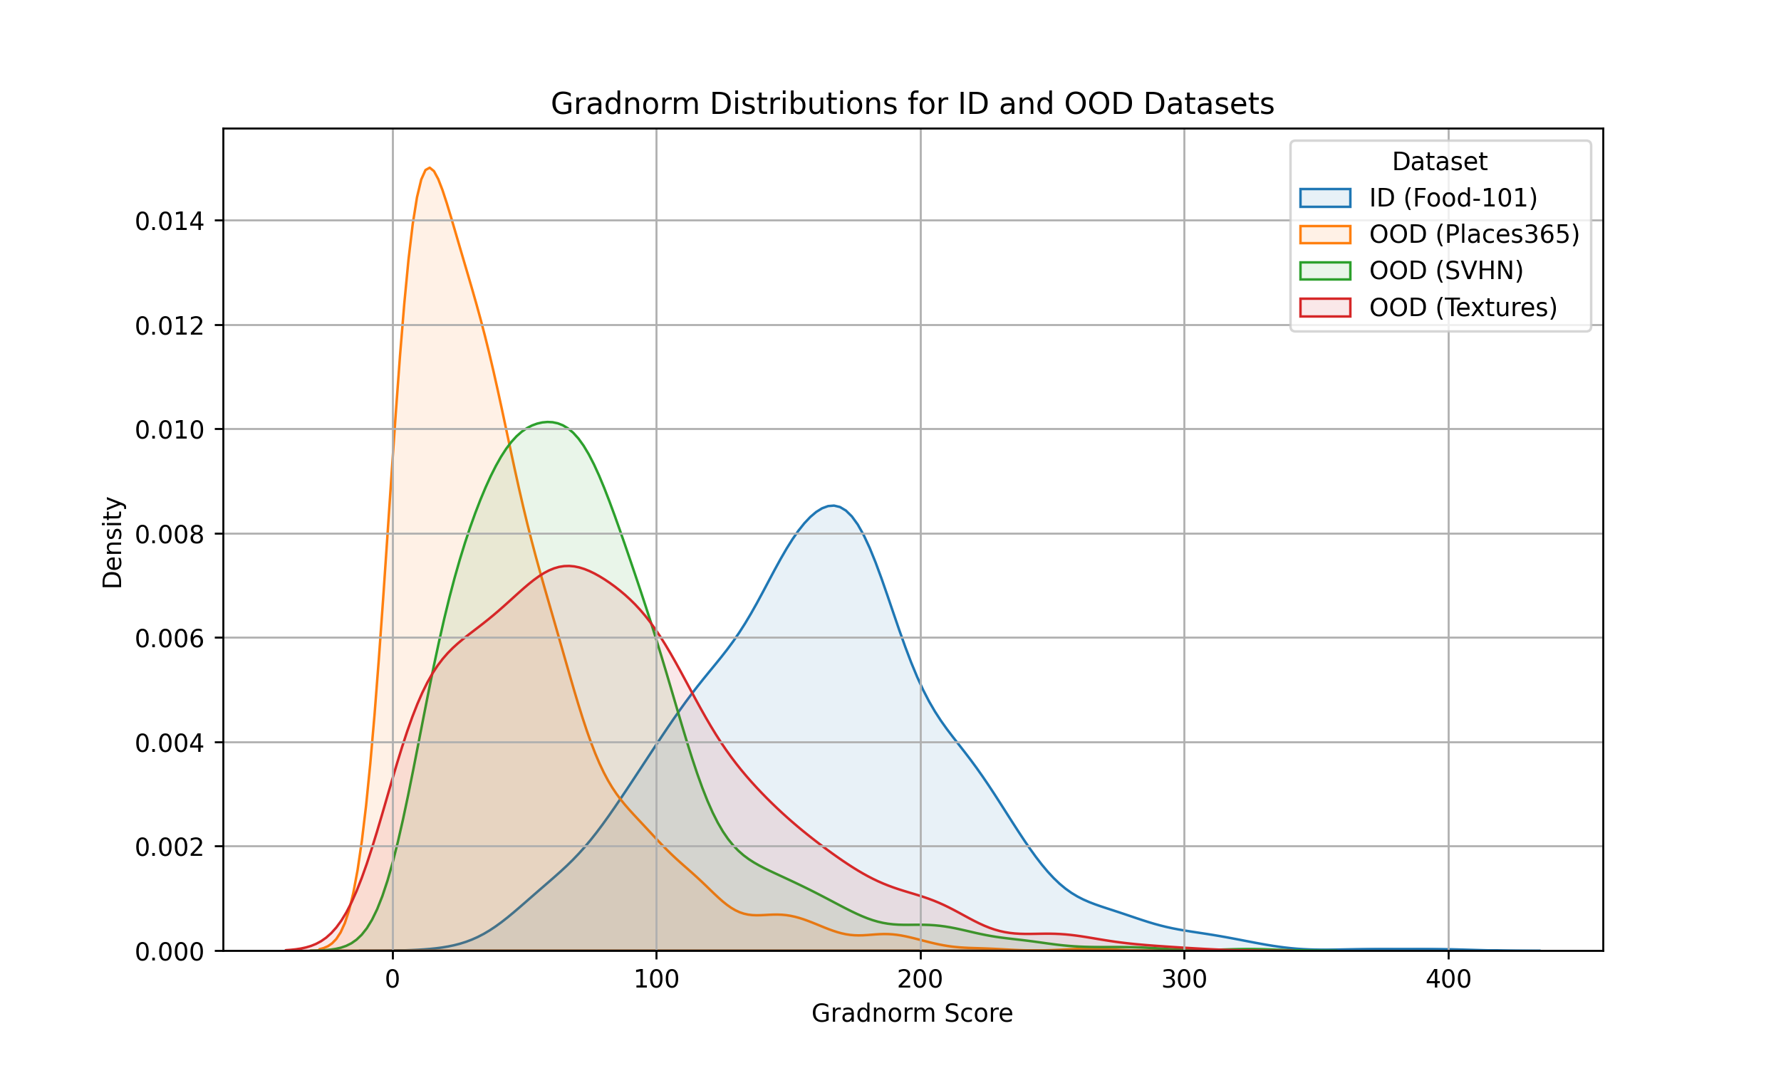
GradNorm
GradNorm utilizes information in the gradient of the KL-Divergence between output logits and a uniform distribution w.r.t. all model parameters^{[7]}

Slide 40
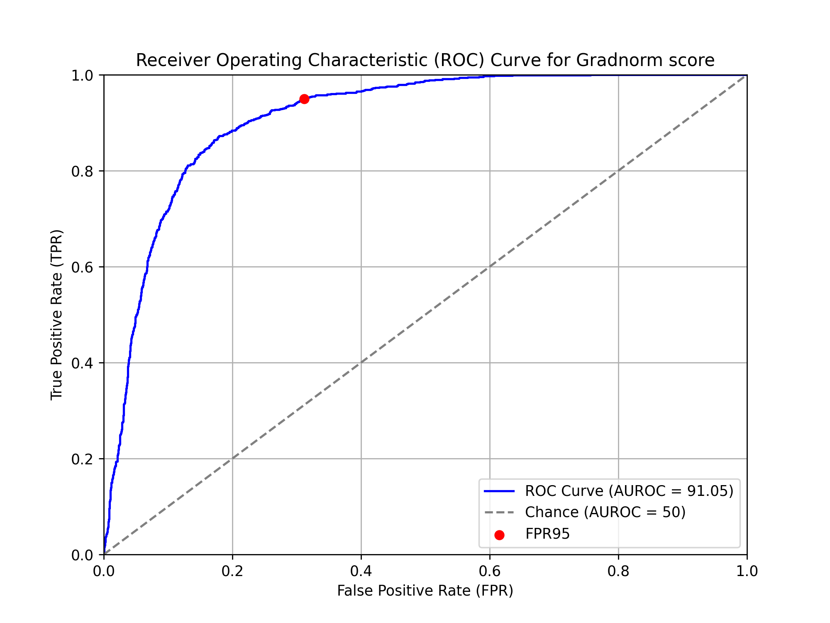
GradNorm

Slide 41
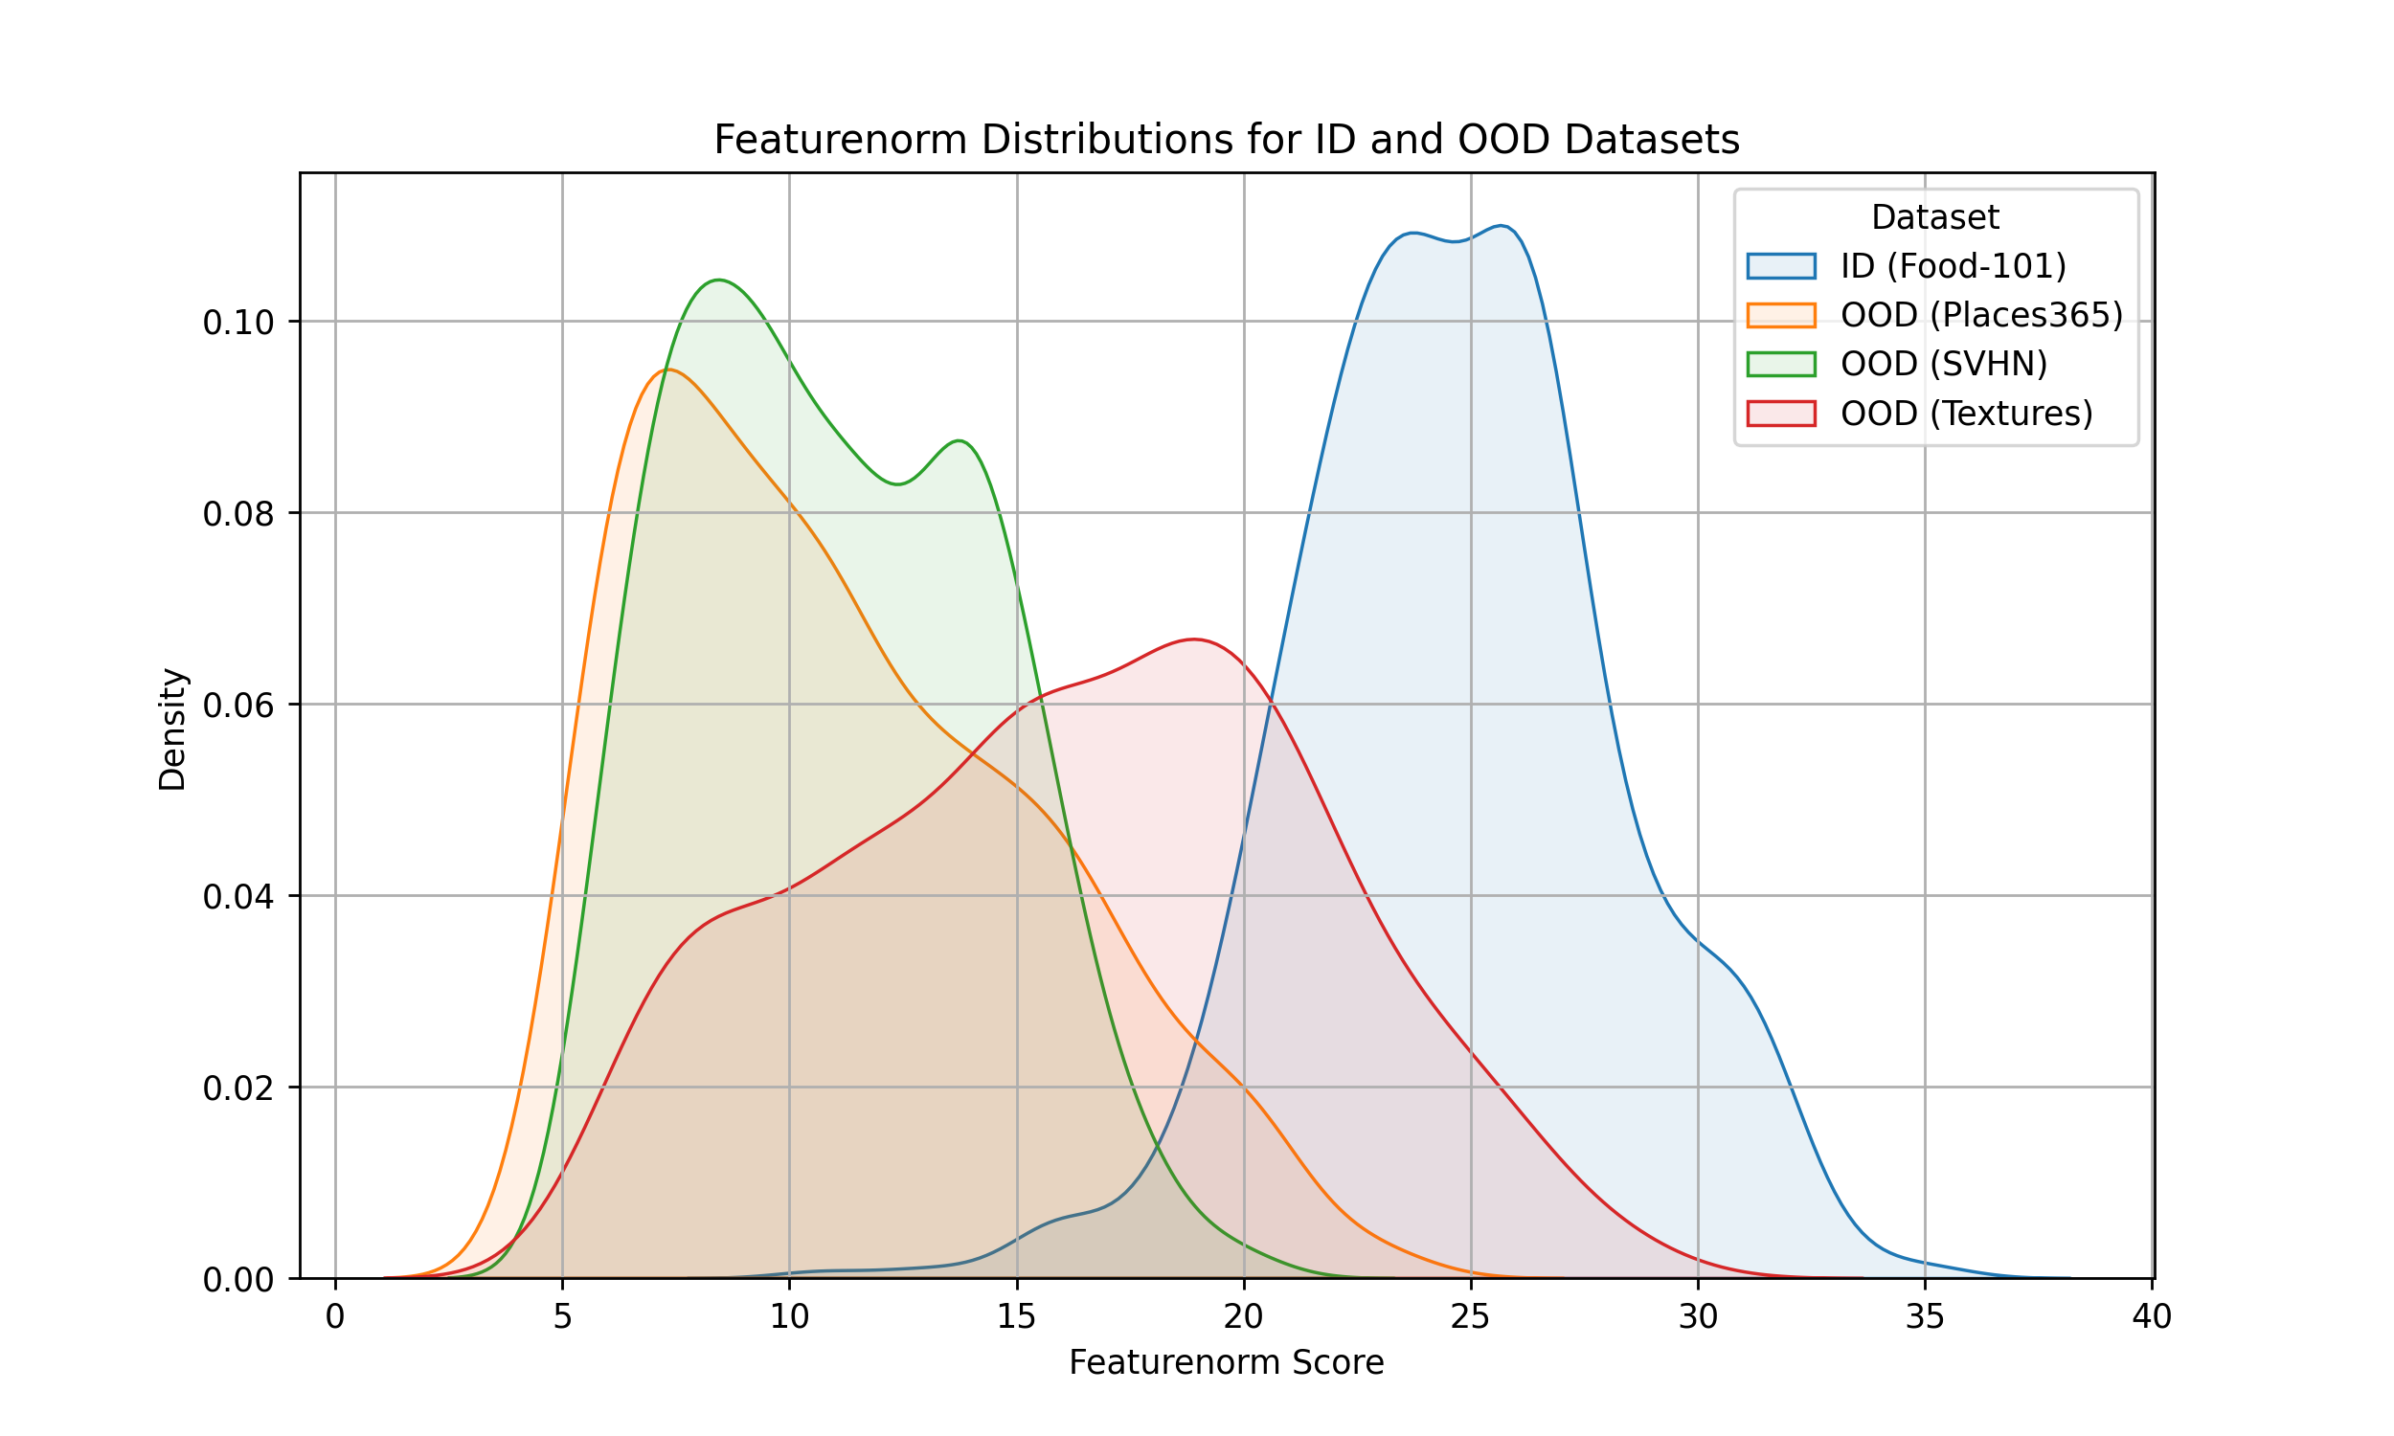
FeatureNorm
FeatureNorm uses the L2-norm of the last feature vector before the final layer to calculate a score^{[6]}

Slide 42
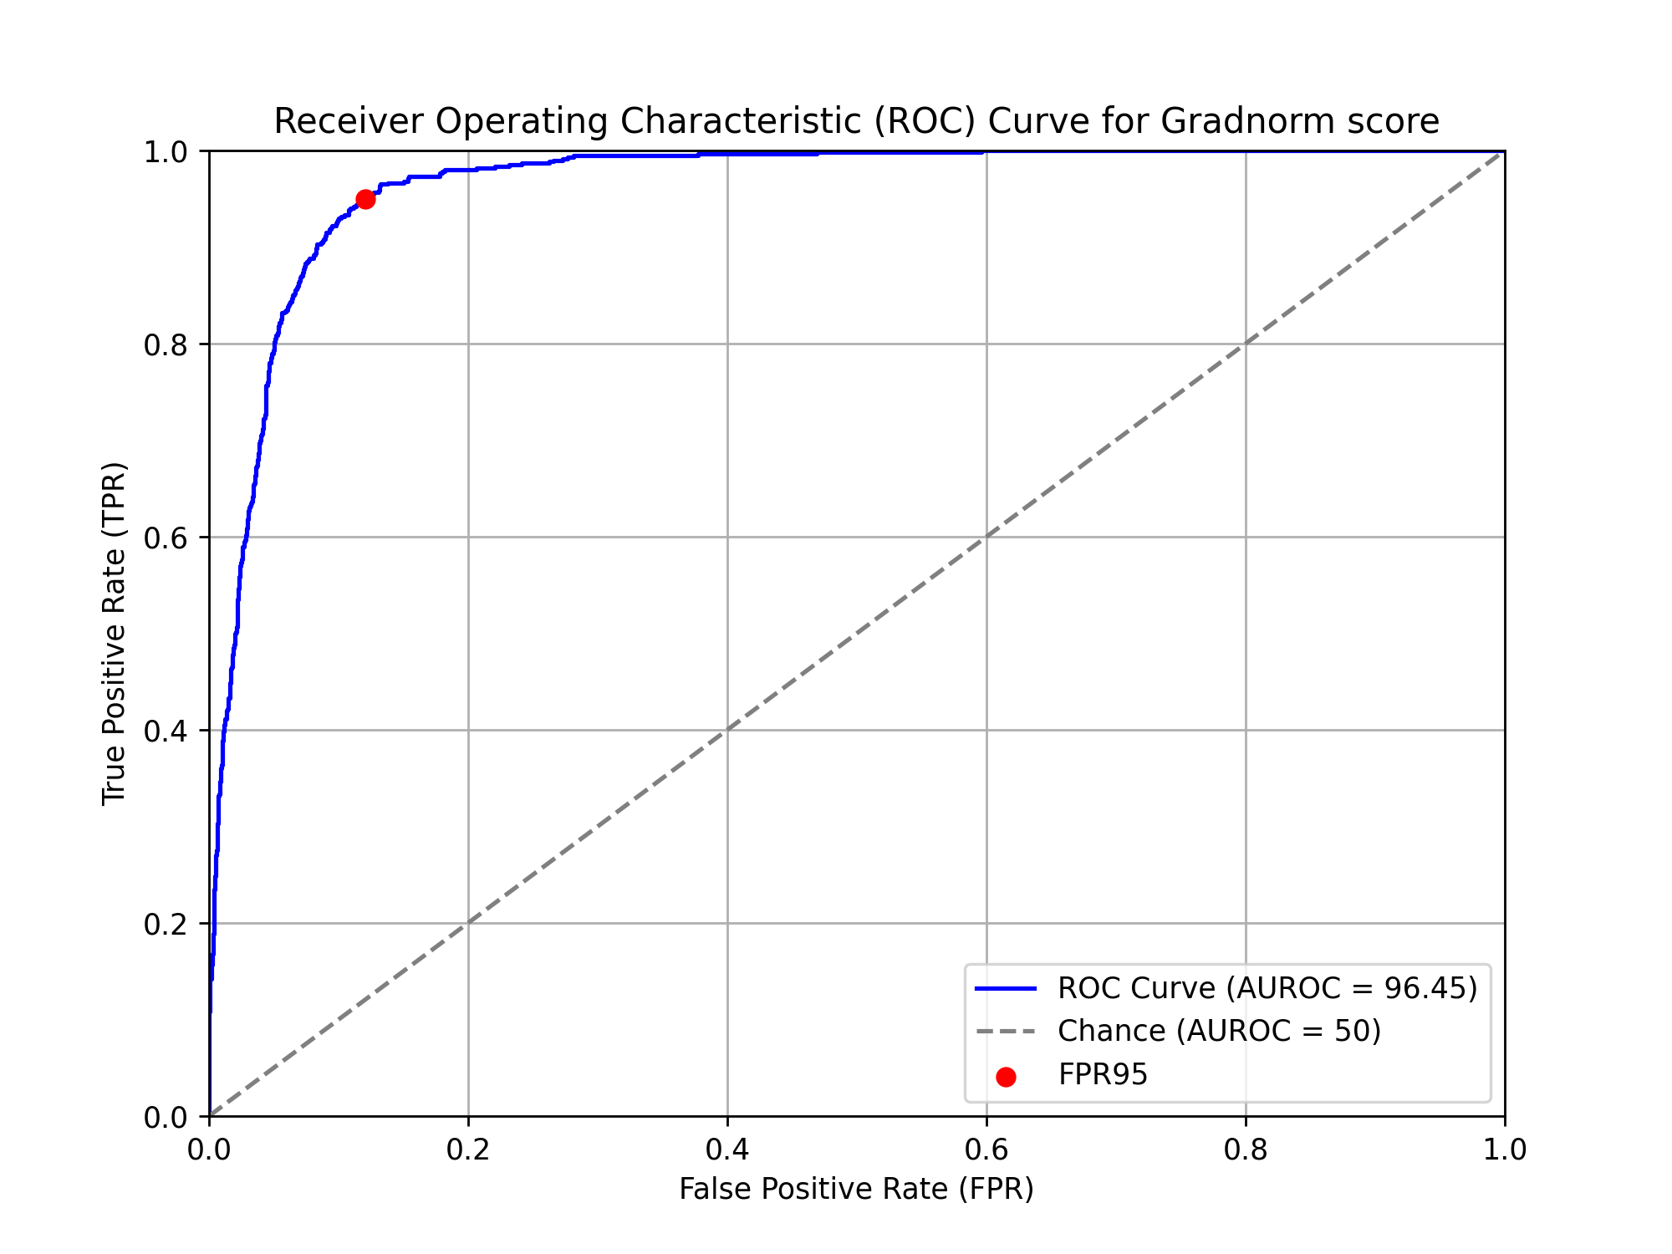
FeatureNorm

Slide 43
Ensemble
Normalize ODIN, Energy, GradNorm and FeatureNorm and then sum them up

Slide 44
Ensemble

Slide 45
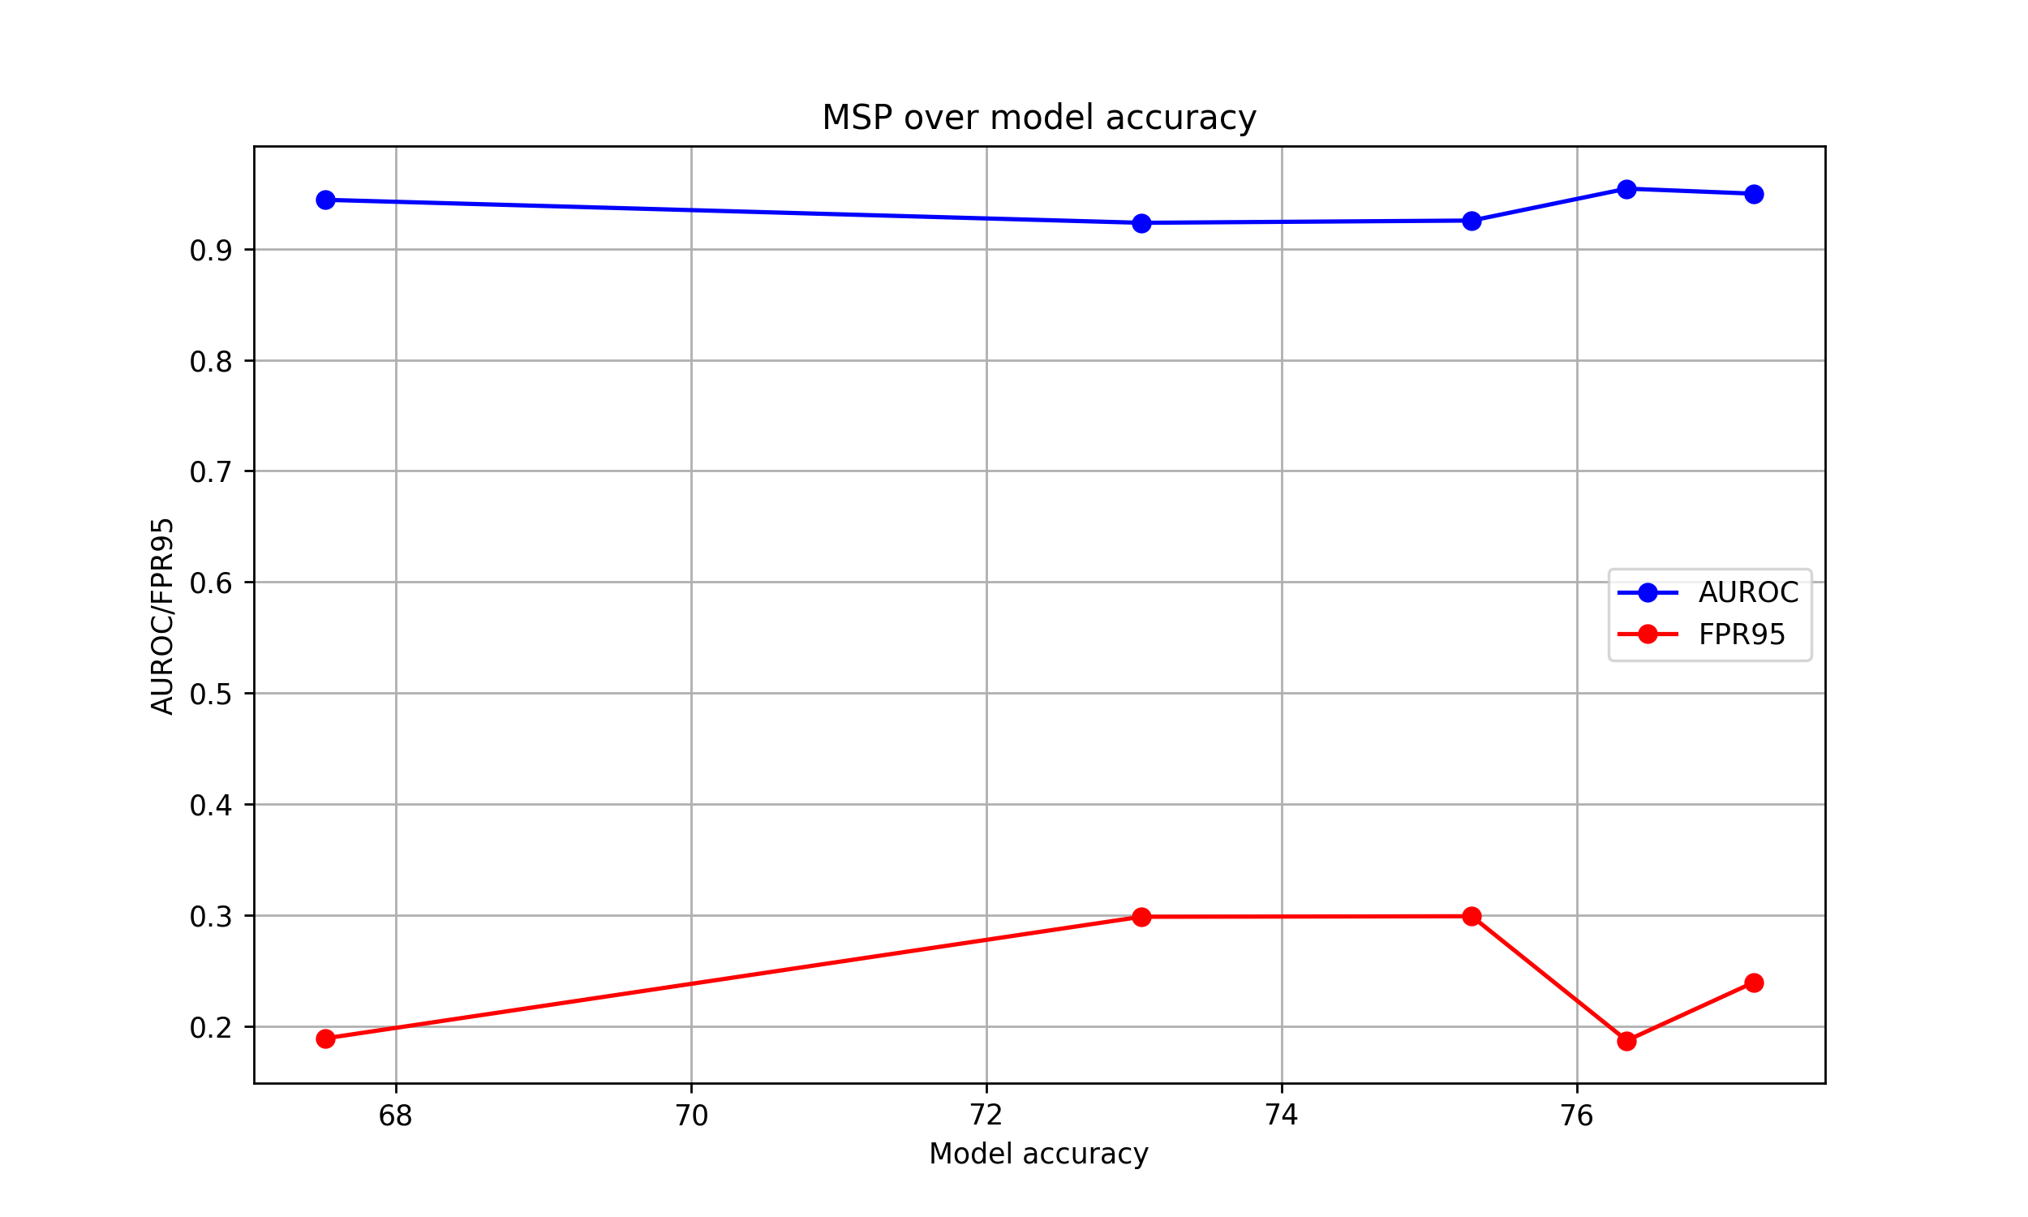
MSP depending on model accuracy

Slide 46
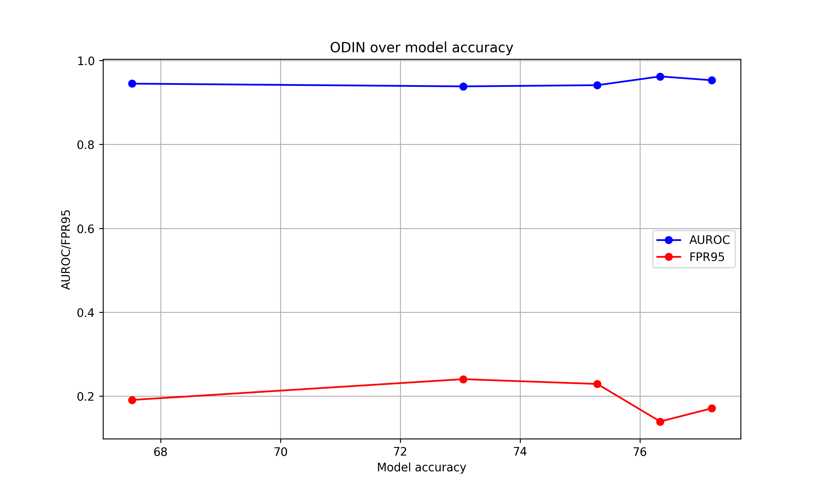
ODIN depending on model accuracy

Slide 47
Energy score depending on model accuracy

Slide 48
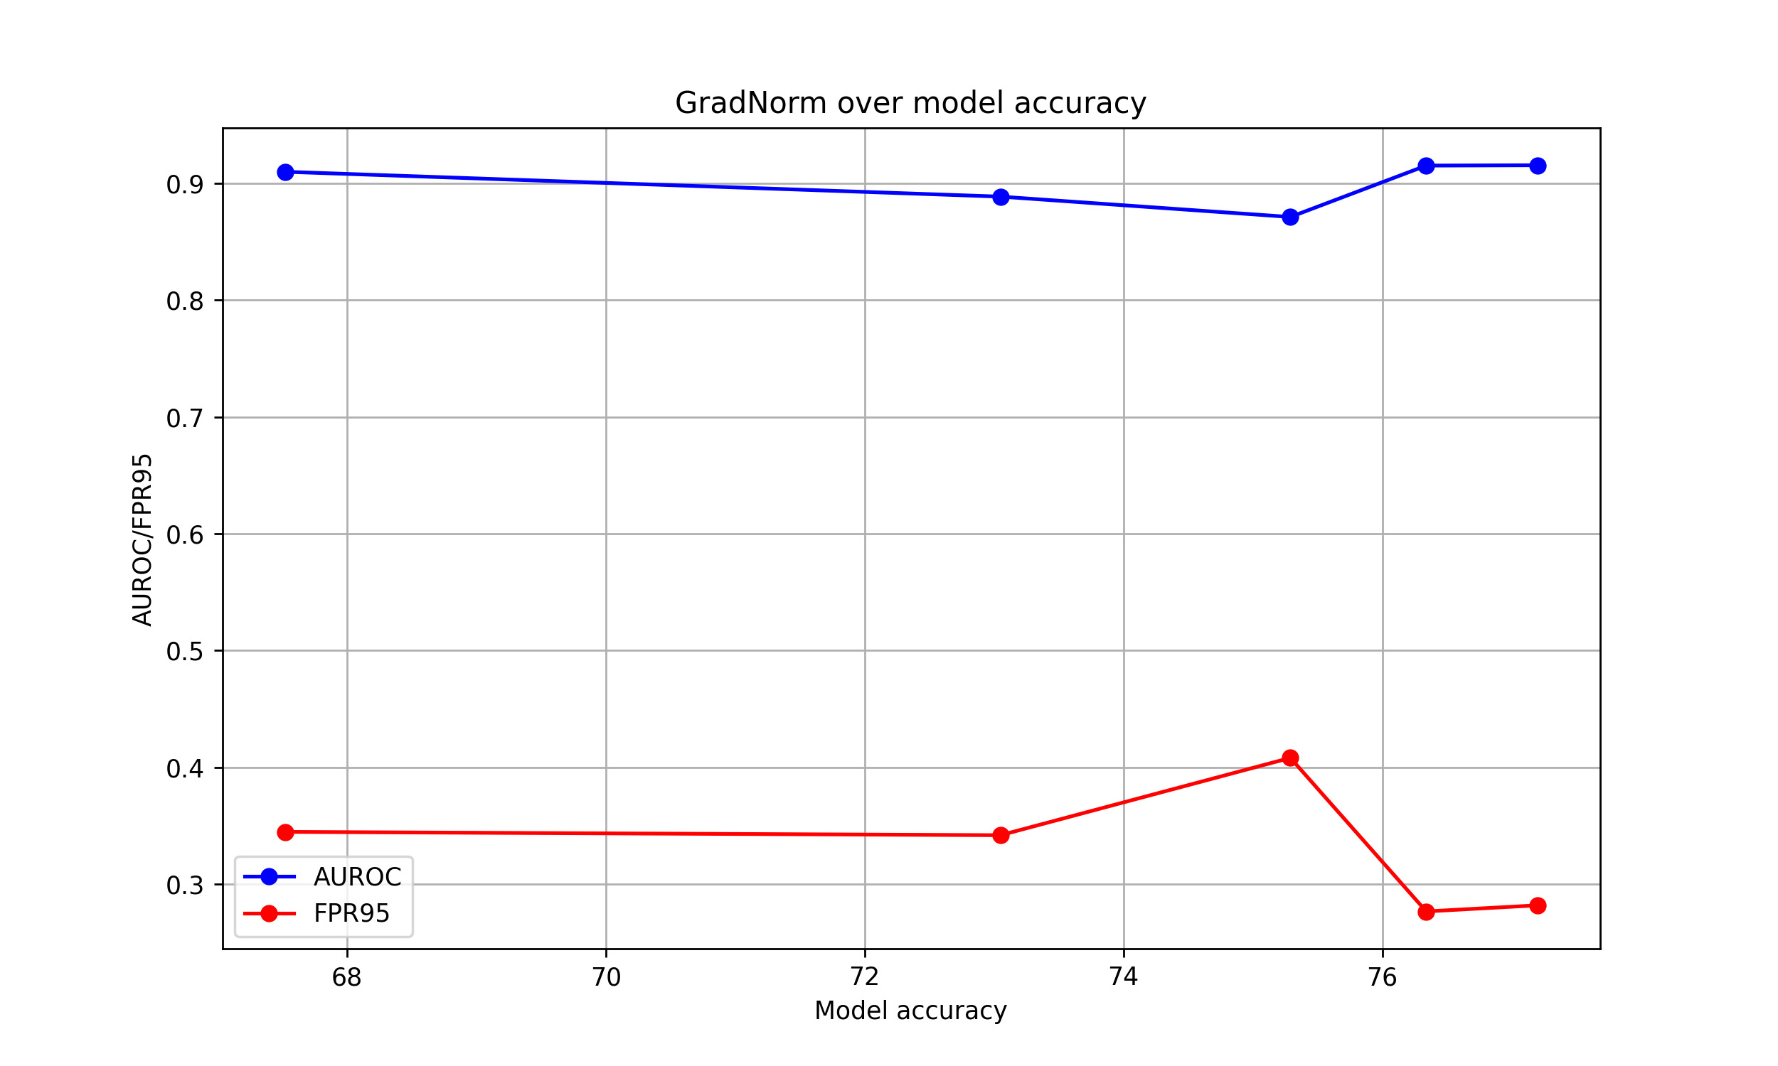
GradNorm depending on model accuracy

Slide 49
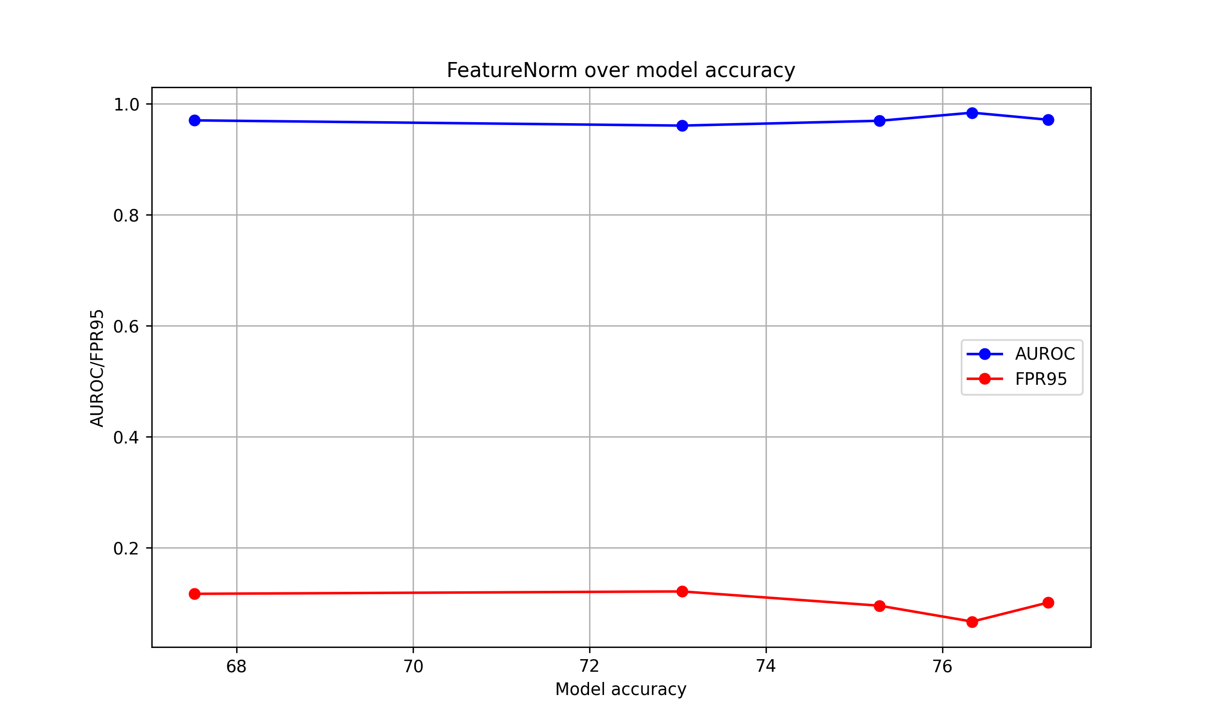
FeatureNorm depending on model accuracy

